Slide 1
Kokkos, a Manycore Device
Performance Portability Library for C++ HPC Applications
H. Carter Edwards, Christian Trott, Daniel Sunderland
Sandia National Laboratories
GPU TECHNOLOGY CONFERENCE 2014
MARCH 24-27, 2013 | SAN JOSE, CALIFORNIA
SAND2014-2317C (Unlimited Release)

Slide 2
Increasingly Complex Heterogeneous Future;
Future-Proof Performance-Portable Code?
Memory Spaces
- Bulk non-volatile (Flash?)
- Standard DDR (DDR4)
- Fast memory (HBM/HMC)
- (Segmented) scratch-pad on die
Execution Spaces
- Throughput cores (GPU)
- Latency-optimized cores (CPU)
- Processing-in-memory (PIM)
Special Hardware
- Non-caching loads
- Read-only cache
- Atomic updates
Scr
Scr
Scr
CG
CG
CG
L1*
Tex
L1*
Tex
L1*
Tex
Programming models
- GPU: CUDA(-ish)
- CPU: OpenMP
- PIM: ??
L2*
PIM
DDR
PIM
L3
NIC
NVRAM
Notes:
Fundamental problems motivating Kokkos:
- Too many programming models (e.g., ways of spelling “parallel for”)
- Optimal data structure layout depends on hardware
- Hardware is only getting more complex – esp. memory hierarchies
- Missing data structures and tools for writing thread-scalable code
- Uncertainty about hardware and programming models; need extension points
Kokkos does NOT:
- Make your algorithms thread scalable. This is at LEAST as hard as getting MPI algorithms to scale.
- Automatically parallelize your code.
- Have a complete set of parallel patterns.
- Deal well with languages other than C++.
Why Kokkos?
- Abstraction over different ways of “spelling” parallel dispatch
- Solve “struct of arrays” / “array of structs” problem
- In general, abstract physical data layout from access syntax
- Get tools for writing thread-scalable code
- Thread-scalable hash table
- Automatic memory management (that scales)
- Atomic updates (more suited to scientific code than C++11’s)
- Path forward for dealing with
- Exotic memory hierarchies
- More interesting data layouts (e.g., tiled, space-filling curves)
- Uncertainty about hardware and programming models

Slide 3
Outline
What is Kokkos
  Layered collection of C++ libraries
  Thread parallel programming model that manages data access patterns
Evaluation via mini-applications
Refactoring legacy libraries and applications
  CUDA UVM (unified virtual memory) in the critical path!
Conclusion

Slide 4
Kokkos: A parallel programming model, as a layered collection of libraries
Standard C++, Not a language extension
  In spirit of Intel’s TBB, NVIDIA’s Thrust & CUSP, MS C++AMP, ...
  Not a language extension: OpenMP, OpenACC, OpenCL, CUDA
Uses C++ template meta-programming
  Currently rely upon C++1998 standard (everywhere except IBM’s xlC)
  Prefer to require C++2011 for lambda syntax
    Need CUDA with C++2011 language compliance
Application & Library Domain Layer
Kokkos Sparse Linear Algebra
Kokkos Containers
Kokkos Core
Back-ends: OpenMP, pthreads, Cuda, vendor libraries ...

Slide 5
Kokkos’ Layered Libraries
Core
  Multidimensional arrays and subarrays in memory spaces
  parallel_for, parallel_reduce, parallel_scan on execution spaces
  Atomic operations: compare-and-swap, add, bitwise-or, bitwise-and
Containers
  UnorderedMap – fast lookup and thread scalable insert / delete
  Vector – subset of std::vector functionality to ease porting
  Compress Row Storage (CRS) graph
  Host mirrored & synchronized device resident arrays
Sparse Linear Algebra
  Sparse matrices and linear algebra operations
  Wrappers for vendors’ libraries
  Portability layer for Trilinos manycore solvers

Slide 6
Kokkos Core: Managing Data Access
Performance Portability Challenge:
Require Device-Dependent Memory Access Patterns
CPUs (and Xeon Phi)
  Core-data affinity: consistent NUMA access (first touch)
  Hyperthreads’ cooperative use of L1 cache
  Alignment for cache-lines and vector units
GPUs
  Thread-data affinity: coalesced access with cache-line alignment
  Temporal locality and special hardware (texture cache)
“Array of Structures” vs. “Structure of Arrays” ?
  This is, and has been, the wrong question
Right question: Abstractions for Performance Portability ?

Slide 7
Kokkos Core: Fundamental Abstractions
Devices have Execution Space and Memory Spaces
  Execution spaces: Subset of CPU cores, GPU, ...
  Memory spaces: host memory, host pinned memory, GPU global memory, GPU shared memory, GPU UVM memory, ...
  Dispatch computation to execution space accessing data in memory spaces
Multidimensional Arrays, with a twist
  Map multi-index (i,j,k,...) ↔ memory location in a memory space
  Map is derived from an array layout
  Choose layout for device-specific memory access pattern
  Make layout changes transparent to the user code;
  IF the user code honors the simple API: a(i,j,k,...)
Separates user’s index space from memory layout

Slide 8
Kokkos Core: Multidimensional Array
Allocation, Access, and Layout
Allocate and access multidimensional arrays
  class View< double * * [3][8] , Device > a (“a”,N,M);
  Dimension [N][M][3][8] ; two runtime, two compile-time
  a(i,j,k,l) : access data via multi-index with device-specific map
  Index map inserted at compile time (C++ template metaprogramming)
Identical C++ ‘View’ objects used in host and device code
Assertions that ‘a(i,j,k,l)’ access is correct
  Compile-time:
    Execution space can access memory space (instead of runtime segfault)
    Array rank == multi-index rank
  Runtime (debug mode)
    Array bounds checking
    Uses CUDA ‘assert’ mechanism on GPU

Slide 9
Kokkos Core: Multidimensional Array
Layout and Access Attributes
Override device’s default array layout
  class View<double**[3][8], Layout , Device> a(“a”,N,M);
  E.g., force row-major or column-major
  Multi-index access is unchanged in user code
  Layout is an extension point for blocking, tiling, etc.
Example: Tiled layout
  class View<double**, TileLeft<8,8> , Device> b(“b”,N,M);
  Layout changes are transparent to user code
  IF the user code honors the a(i,j,k,...) API
Data access attributes – user’s intent
  class View<const double**[3][8], Device, RandomRead> x = a ;
  Constant + RandomRead + GPU → read through GPU texture cache
  Otherwise invisible to user code

Slide 10
Kokkos Core: Deep Copy Array Data
NEVER have a hidden, expensive deep copy
Only deep copy when explicitly instructed by user code
Avoid expensive permutation of data due to different layouts
  Mirror the layout in Host memory space
  typedef class View<...,Device> MyViewType ;
  MyViewType a(“a”,...);
  MyViewType::HostMirror a_h = create_mirror( a );
  deep_copy( a , a_h ); deep_copy( a_h , a );
Avoid unnecessary deep-copy
  MyViewType::HostMirror a_h = create_mirror_view( a );
  If Device uses host memory or if Host can access Device memory space (CUDA unified virtual memory)
  Then ‘a_h’ is simply a view of ‘a’ and deep_copy is a no-op

Slide 11
Kokkos Core: Dispatch Data Parallel Functors
‘NW’ units of data parallel work
parallel_for( NW , functor )
  Call functor( iw ) with iw ∈ [0,NW) and #thread ≤ NW
parallel_reduce( NW , functor )
  Call functor( iw , value ) which contributes to reduction ‘value’
  Inter-thread reduction via functor.init(value) & functor.join(value,input)
  Kokkos manages inter-thread reduction algorithms and scratch space
parallel_scan( NW , functor )
  Call functor( iw , value , final_flag ) multiple times (possibly)
  if final_flag == true then ‘value’ is the prefix sum for ‘iw’
  Inter-thread reduction via functor.init(value) & functor.join(value,input)
  Kokkos manages inter-thread reduction algorithms and scratch space

Slide 12
Kokkos Core: Dispatch Data Parallel Functors
League of Thread Teams (grid of thread blocks)
parallel_for( { #teams , #threads/team } , functor )
  Call functor( teaminfo )
  teaminfo = { #teams, team-id, #threads/team, thread-in-team-id }
parallel_reduce( { #teams , #threads/team } , functor )
  Call functor( teaminfo , value )
parallel_scan( { #teams , #threads/team } , functor )
  Call functor( teaminfo , value , final_flag )
A Thread Team has
  Concurrent execution with intra-team collectives (barrier, reduce, scan)
  Team-shared scratch memory (e.g., uses GPU “shared memory”)
  Exclusive use of CPU and Xeon Phi cores while executing

Slide 13
Kokkos Core: Manage Memory Access Pattern
Compose Parallel Dispatch ○ Array Layout
Parallel Dispatch
  Maps calls to functor(iw) onto threads
  GPU: iw = threadIdx + blockDim * blockIds
  CPU: iw ∈[begin,end)_{Th} ; contiguous partitions among threads
Multidimensional Array Layout
  Contract: leading dimension (right most) is parallel work dimension
    Leading multi-index is ‘iw’ : a( iw , j,k,l)
  Choose array layout for required access pattern
    Choose “array of structs” for CPU and “struct of arrays” for GPU
Fine-tuning
  E.g., padding dimensions for cache line alignment

Slide 14
Kokkos Containers
Kokkos::DualView< type , device >
  Bundling a View and its View::HostMirror into a single class
  Track which View was most recently updated
  Synchronize: deep copy from most recently updated view to other view
    Host → device OR device → host
  Capture a common usage pattern into DualView class
Kokkos::Vector< type , device >
  Thin layer on rank-one View with “look & feel” of std::vector
  No dynamic sizing from the device execution space
    Thread scalability issues
  Aid porting of code using std::vector
    That does not dynamically resize within a kernels

Slide 15
Kokkos Containers: Unordered Map
Thread scalable
  Lock-free implementation with minimal/essential use of atomics
  API deviates from C++11 unordered map
    No on-the-fly allocation / reallocation
    Index-based instead of iterator-based
Insert (fill) within a parallel reduce functor
  Functor: {status, index} = map.insert(key,value);
    Status = success | existing | failed due to insufficient capacity
    Reduction on failed-count to resize the map
  Host:
    UnorderedMap<Key,Value,Device> map ;
    do {
    map.rehash( capacity );
    capacity += ( nfailed = parallel_reduce( NW , functor ) );
    } while( nfailed ); // should iterate at most twice

Slide 16
Unordered Map Performance Evaluation
Parallel-for insert to 88% full with 16x redundant inserts
  NW = number attempts to insert = Capacity * 88% * 16
  Near – contiguous work indices [iw,iw+16) insert same keys
  Far – strided work indices insert same keys
Single “Device” Performance Tests
  NVidia Kepler K40 (Atlas), 12Gbytes
  Intel Xeon Phi (Knights Corner) COES2, 61 cores, 1.2 GHz, 16Gbytes
    Limit use to 60 cores, 4 hyperthreads/core
  K40X dramatically better performance
  Xeon Phi implementation optimized using explicit non-caching prefetch
  Theory: due to cache coherency protocols and atomics’ performance

Slide 17
Outline
What is Kokkos
Evaluation via mini-applications
  MiniMD molecular dynamics
  MiniFE Conjugate Gradient (CG) iterative solver
  MiniFENL sparse matrix construction
Refactoring legacy libraries and applications
  CUDA UVM (unified virtual memory) in the critical path!
Conclusion

Slide 18
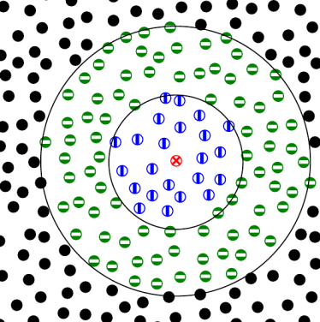
MiniMD Performance
Lennard Jones force model using atom neighbor list
Solve Newton’s equations for N particles
Simple Lennard Jones force model:
Use atom neighbor list to avoid N² computations
Moderately compute bound computational kernel
On average 77 neighbors with 55 inside of the cutoff radius
pos_i = pos(i);
for( jj = 0; jj < num_neighbors(i); jj++) {
j = neighbors(i,jj);
r_ij = pos_i – pos(j); //random read 3 floats
if ( |r_ij| < r_cut )
f_i += 6*e*( (s/r_ij)^7 – 2*(s/r_ij)^13 )
}
f(i) = f_i;

Slide 19
MiniMD Performance
Lennard Jones (LJ) force model using atom neighbor list
  Test Problem (#Atoms = 864k, ~77 neighbors/atom)
  Neighbor list array with correct vs. wrong layout
    Different layout between CPU and GPU
  Random read of neighbor coordinate via GPU texture fetch
Large loss in performance with wrong layout
  Even when using GPU texture fetch
  Kokkos, by default, selects the correct layout

Slide 20
MiniFE CG-Solver on Sandia’s Testbeds
Kokkos competitive with “native” implementations
Finite element mini-app in Mantevo (mantevo.org)
  CG solve of finite element heat conduction equation
Numerous programming model variants
  More than 20 variants in Mantevo repository (eight in release 2.0)
Evaluating hardware testbeds and programming models

Slide 21
MiniFENL: Mini driver Application
Solve nonlinear finite element problem via Newton iteration
  Focus on construction and fill of sparse linear system
  Thread safe, thread scalable, and performant algorithms
  Evaluate thread-parallel capabilities and programming models
Construct maps (for assembly) and sparse linear system
  Sparse linear system graph : node-node map
  Element-graph map for scatter-atomic-add assembly algorithm
  Graph-element map for gather-sum assembly algorithm
Compute nonlinear residual and Jacobian
  Iterate elements to compute per-element residual and Jacobian
    Scatter-atomic-add values into linear system
    Save values in gather-sum scratch array
  Iterate rows, gather data from scratch array, sum into linear system
Solve linear system for Newton iteration

Slide 22
Scatter-Atomic-Add vs. Gather-Sum
Map: Mesh → Sparse Graph
Finite Element Data
Scatter-Atomic-Add Pattern
Gather-Sum Pattern
Element Computations
Element
Computations
+ Scatter-Add
very large Scratch Arrays
atomic_add
add
Gather-Sum
Sparse Linear System
Coefficients
Notes:
The point is to resolve conflicts.
Conflicts happen in sparse matrix entries.
Each interaction between basis functions causes a potential conflict, since the integration of each of those basis functions contributes to the total value at that sparse matrix entry.
Scatter-atomic-add deals with conflicts using atomic updates.
Gather-sum deals with conflicts by duplicating entries for all possible conflicts.
The latter causes a memory increase that grows both with spatial dimensionality, and with finite element order.
However, it does not require locking or atomics. It trades memory to avoid conflicts.

Slide 23
Scatter-Atomic-Add vs. Gather-Sum
Both are thread-safe and thread-scalable
Scatter-Atomic-Add
  Simple implementation
  Fewer global memory reads and writes
  Atomic operations much slower than corresponding regular operation
  Non-deterministic order of additions – floating point round off variability
  Double precision atomic add is a looped compare-and-swap (CAS)
Gather-Sum
  Deterministic order of additions – no round off variability
  Extra scratch arrays for element residuals and Jacobians
  Additional parallel-for
Performance comparison – execution time
  Neglecting the time to pre-compute mapping(s), assuming re-use
  Cost of atomic-add vs. additional parallel-for for the gather-sum

Slide 24
Performance Comparison: Element+Fill
ScatterAtomic as good or better without extra scratch memory
Phi: ScatterAtomicAdd ~equal to GatherSum
  ~2.1x speed up from 1 to 4 threads/core – hyperthreading
Kepler: ScatterAtomicAdd ~40% faster than GatherSum
  Fewer global memory writes and reads
  Double precision atomic-add via compare-and-swap algorithm
  Plan to explore element coloring to avoid atomics for scatter-add

Slide 25
Thread Scalable CRS Graph Construction
Fill unordered map with elements’ (row-node, column-node)
  Parallel-for of elements, iterate node-node pairs
  Successful insert to node-node unordered map denotes a unique entry
  Column count = count unique entries for each row-node
Construct (row-node, column-node) sparse graph
  Parallel-scan of row-node column counts (“# entries per row”)
    This is now the CRS row offset array
  Allocate CRS column index array
  Parallel-for on node-node unordered map to fill CRS column index array
  Parallel-for on CRS graph rows to sort each row’s column indices
Thread scalable pattern for construction
  Parallel count
  Allocate
  Parallel fill
  Parallel post-process

Slide 26
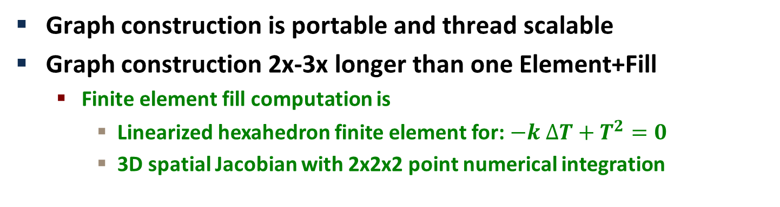
Performance: CRS Graph Construction
Graph construction is portable and thread scalable
Graph construction 2x-3x longer than one Element+Fill
  Finite element fill computation is
    Linearized hexahedron finite element for: $−k ∆T+T^{2}=0$
    3D spatial Jacobian with 2x2x2 point numerical integration

Slide 27
Outline
What is Kokkos
Evaluation via mini-applications
Refactoring legacy libraries and applications
  CUDA UVM (unified virtual memory) in the critical path!
  From pure MPI parallelism to MPI + Kokkos hybrid parallelism
  Tpetra: Open-source foundational library for sparse solvers
  LAMMPS: Molecular dynamics application
Conclusion

Slide 28
Tpetra: Foundational Layer / Library for
Sparse Linear Algebra Solvers
Tpetra: Sandia’s templated C++ library for sparse linear algebra
  Distributed memory (MPI) vectors, multi-vectors, and sparse matrices
  Data distribution maps and communication operations
  Fundamental computations: axpy, dot, norm, matrix-vector multiply, ...
  Templated on “scalar” type: float, double, automatic differentation, polynomial chaos, ...
Higher level solver libraries built on Tpetra
  Preconditioned iterative algorithms
  Incomplete factorization preconditioners
  Multigrid solvers
Early internal prototype for portable thread-level parallelism
  Did not address array layouts or access traits, used raw pointers
  Limited use / usability outside of internal Tpetra implementation

Slide 29
Tpetra: Foundational Layer / Library for
Sparse Linear Algebra Solvers
Incremental Porting of Tpetra to (new) Kokkos
  Maintain backward internal compatibility during transition
  Change internal implementation of data structures
      Kokkos Views with prescribed layout to match existing layout
      Extract raw pointers for use by existing computational kernels
  Incrementally refactor kernels to use Kokkos Views
Status
  Vector, MultiVector, and CrsMatrix data structures using Kokkos Views
  Basic linear algebra kernels working
  CUDA, OpenMP, and Pthreads back-ends operational
CUDA UVM (unified virtual memory) critical for transition
  Sandia’s early access to CUDA 6.0 via Sandia/NVIDIA collaboration
  Refactoring can neglect deep-copy and maintain correct behavior
  Allows incremental insertion of deep-copies as needed for performance

Slide 30
CUDA UVM Expedites Refactoring Legacy Code
UVM memory space accessible to all execution spaces
  Hard to find all points in legacy code where deep copy is needed
  Start with UVM allocation for all Kokkos View device allocations
  Hide special UVM allocator within Kokkos’ implementation
Basics of UVM (without CUDA streams)
  Automatic host->device deep copy at kernel dispatch
    For UVM data updated on the host
  Automatic device->host deep copy when accessing UVM on the host
    Per memory page granularity
Limitations
  Requires compute capability 3.0 or greater (Kepler)
  Total UVM memory space allocations limited by device memory
  Host access to UVM data forbidden during kernel execution
    Enforce by executing with CUDA_LAUNCH_BLOCKING=1

Slide 31
CG-Solve: Tpetra+Kokkos versus MiniFE+Kokkos
On dual Intel Sandybridge + K20x testbed
Time (seconds)
# of Compute Nodes
Performance issues identified
  Currently Tpetra with CUDA back-end slower and not scaling
  Due to Tpetra implementation or CUDA/UVM back-end ?
30

Slide 32
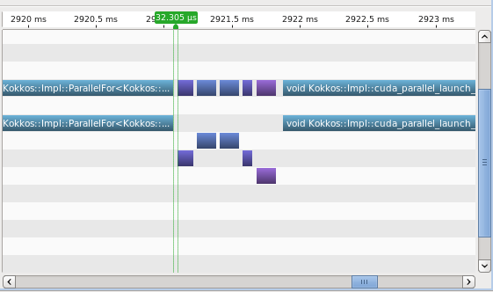
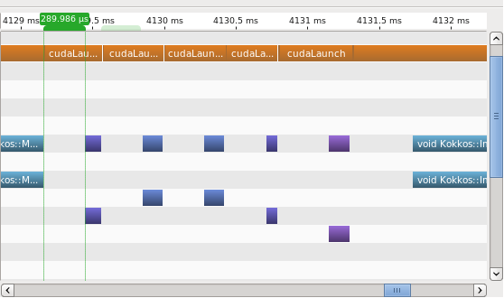
Analysis of Tpetra slowdown on CUDA
Profiling problem using MiniFE with and without UVM
  Tpetra refactoring relies upon UVM
  MiniFE quickly modified to use UVM
  Identified performance issue with kernel launch + UVM
300us kernel launch overhead
30us kernel launch overhead
MiniFE without UVM (original)
MiniFE with UVM allocations

Slide 33
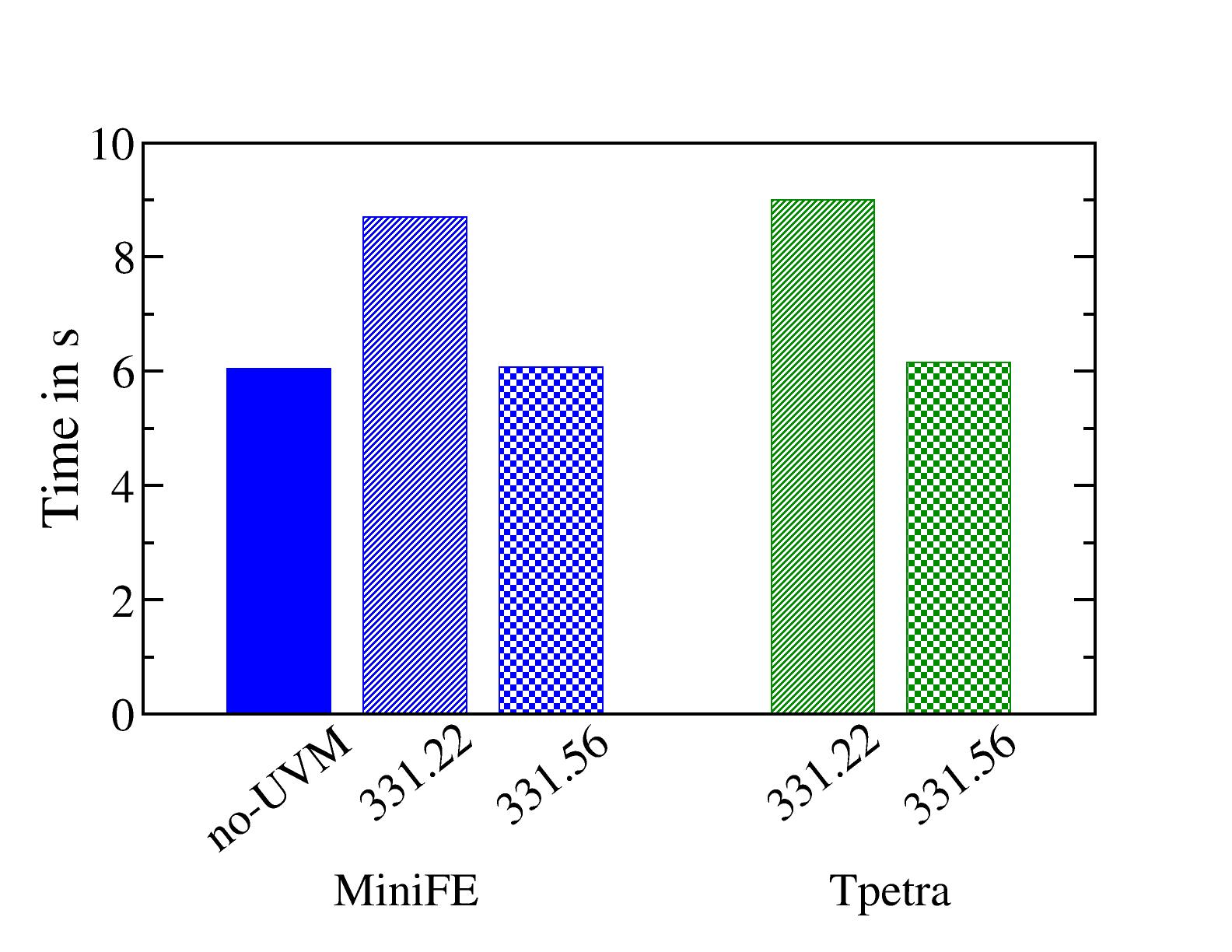
Tpetra/MiniFE/Kokkos/UVM – Epilogue
Early identification of problem leading to fix by NVIDIA
  Fixed in alpha-driver (#331.56) – soon be publically available
  Win-win: Tpetra/Kokkos expedited porting + early feedback to NVIDIA
32

Slide 34
LAMMPS Porting to Kokkos has begun
LAMMPS molecular dynamics application (lammps.sandia.gov)
Goal
  Enable thread scalability throughout code
  Replace specialized thread-parallel packages
    Reducing code redundancy by 3x
Leverage algorithmic exploration from miniMD
  MiniMD: molecular dynamics mini-app in Mantevo
  Transfer thread-scalable algorithms from miniMD to LAMMPS
Release with optional use of Kokkos in April 2014
  Implement framework: data management and device management
  All parts of some simple simulations can run on device via Kokkos

Slide 35
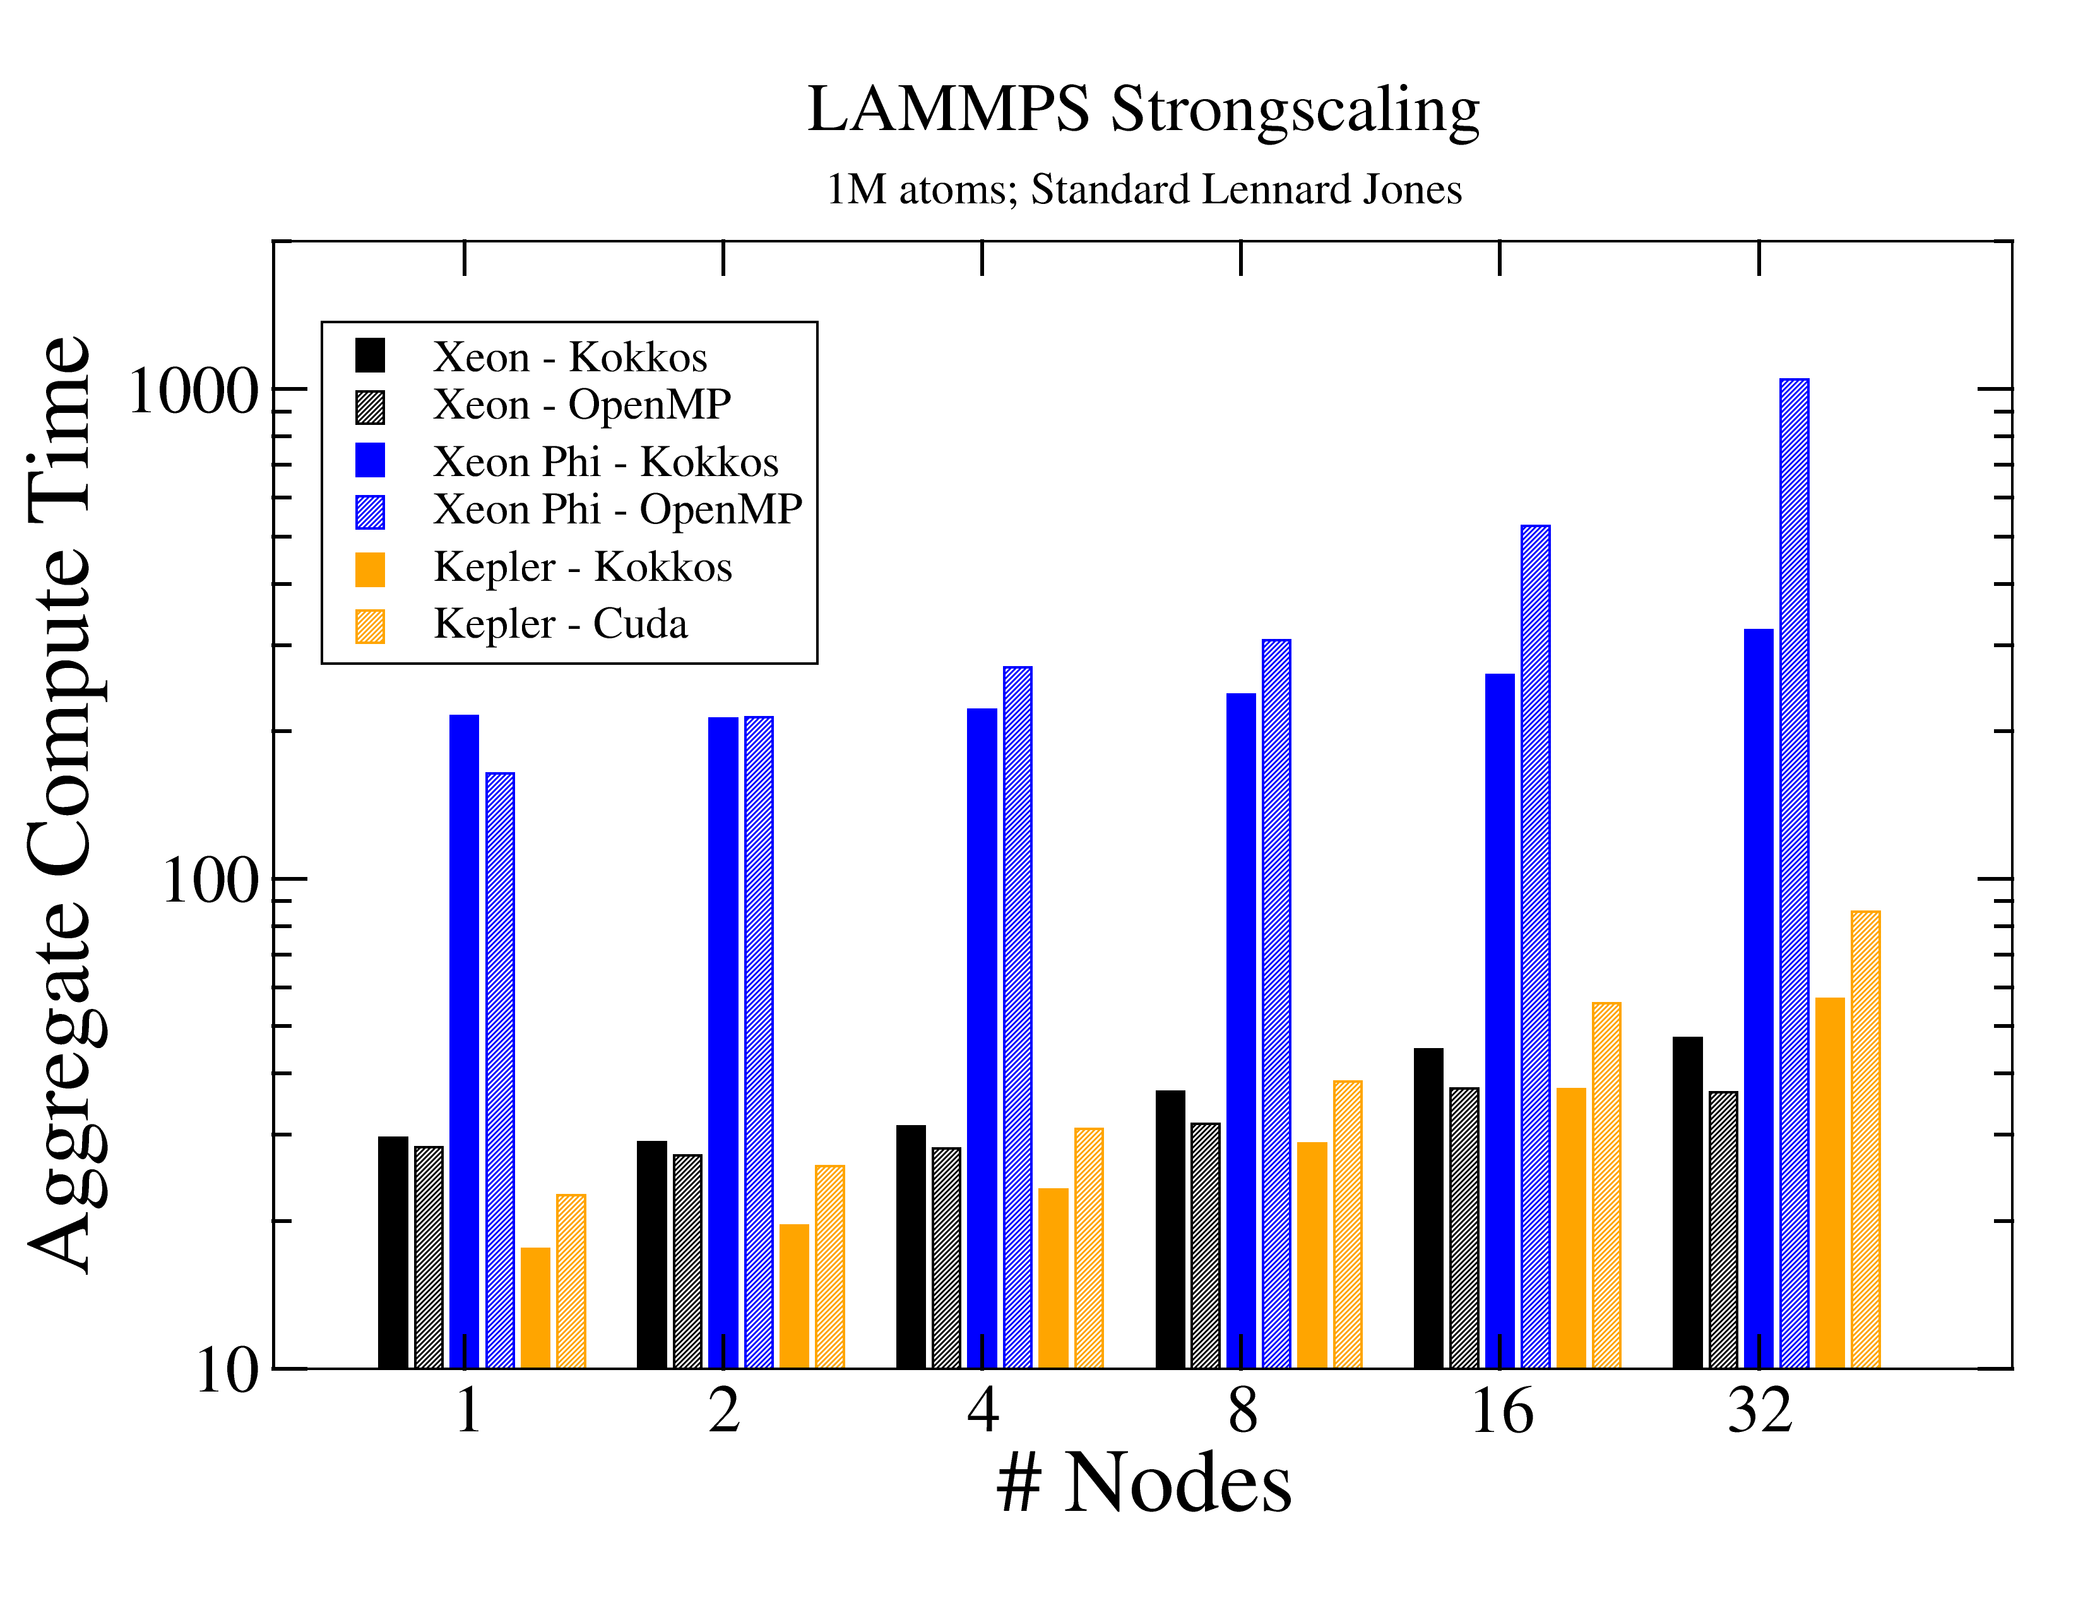
LAMMPS Porting to Kokkos early results
Strong scaling “aggregate compute time” = wall clock * # compute nodes
Performing as well or better than original non-portable threaded code

Slide 36
LAMMPS Hybrid Parallel Execution Performance
All kernels compiled for both Host and Device
  Choose kernels’ execution space at runtime
Host-device data transfer managed with DualViews
  Allow legacy code still to run on the host
Experiment: DeepCopy versus UVM managed data transfers
  Time integration on CPU (1 or 8 Threads), everything else on GPU
  1000 timesteps, 16k atoms, standard LJ force kernel
 | Time Step | Data Transfer | # of Dev->Host | Time Dev->Host
DeepCopy (8T) | 1,870us | 340us | 2 (2*740kB) | 113us per 740k
UVM (1T) | 3,820us | *2,290us | ~250 (4k pages) | ~8us per 4k
UVM (8T) | 6,620us | *5,090us | ~290 (4k pages) | ~18us per 4k
UVM 4k page transfer latency ~best expected for PCI bus
  Slow down when Host has more than one idling thread
Explicit deep copy of large array out-performs per-page UVM

Slide 37
Conclusion
Kokkos Layered Libraries / Programming Model
  Data parallel (for, reduce, scan) dispatch to execution spaces
  Multidimensional arrays with polymorphic layout in memory spaces
  Parallel dispatch ○ polymorphic layout → manage data access pattern
  AoS versus SoA solved with appropriate abstractions using C++ templates
  UnorderedMap with thread scalable insertion
Evaluation with Mini-Applications
  Polymorphic array layout critical for performance portability
  Kokkos-portable kernels’ performance as good as native implementations
  Scatter-atomic-add is a performant option for linear system fill
  CRS graph construction can be thread scalable
Transition of Legacy Codes
  Incremental porting necessary and tractable with CUDA UVM
  Refactored-in deep copy semantics needed for best performance

