Slide 1
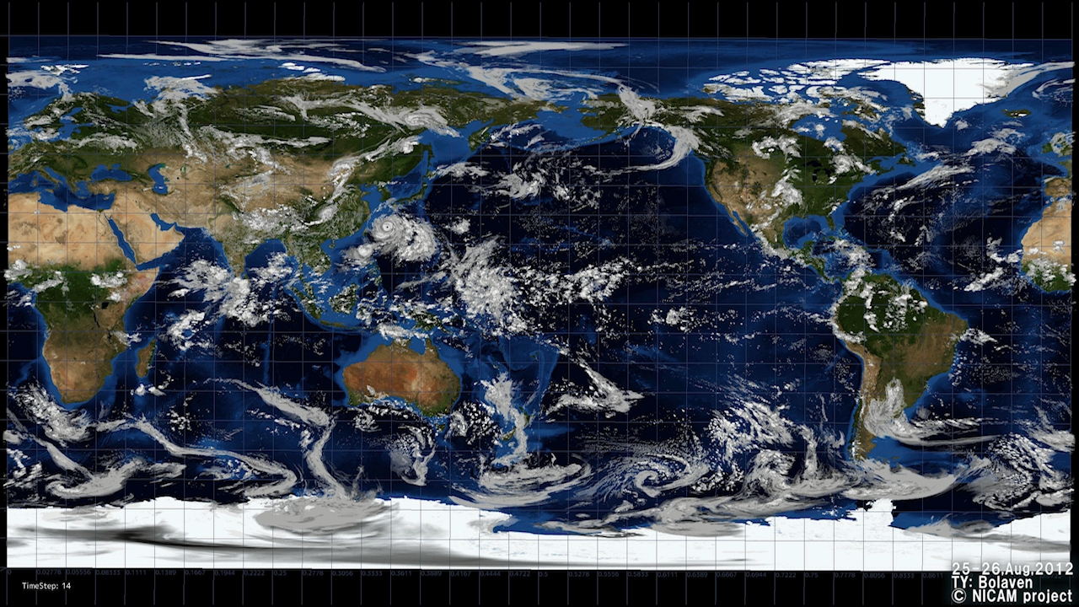
A Super High-Resolution Global Atmospheric Simulation by the Nonhydrostatic Icosahedral Atmospheric Model (NICAM) using the K-computer
Group web page http://nicam.jp
Masaki Satoh
（Atmosphere and Ocean Research Institute, UTokyo/JAMSTEC)
Thanks to the NICAM group (AORI, JAMSTEC, AICS)
VECPAR 2014, 11th International Meeting High Performance Computing for Computational Science
June 30 - July 3, 2014 University of Oregon and Hilton Conference Center Eugene, Oregon, USA

Slide 2
Outline
Background of the research
Introduction to NICAM
  Example: Athena project
  ICOMEX
  NICAM numerics
  Computational strategy
Main topics of researches
  MJO studies on the Earth Simulator
K-computer studies
  More resolution: dx=870m
  More ensemble studies: MJO case sweep exp.
  Earth observation collaborations
  Longer integration: future change in tropical cyclones

Slide 3
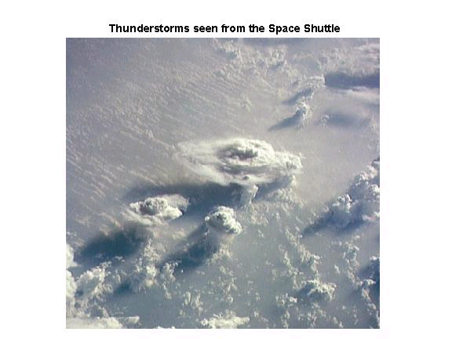
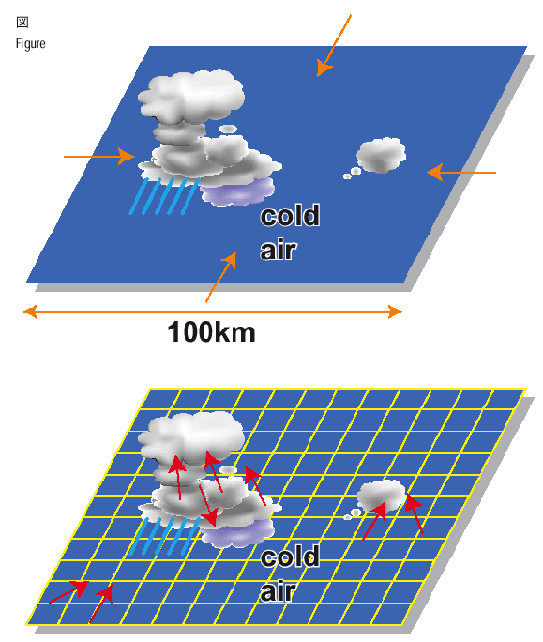
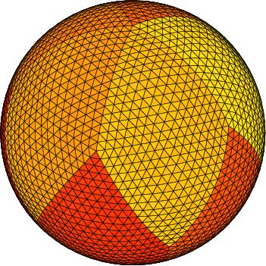
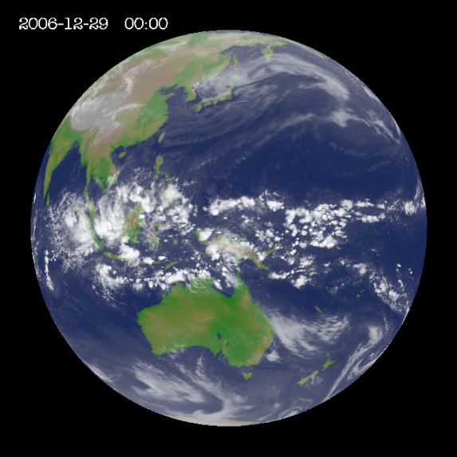
Background of the research
Importance of deep convection in global atmospheric circulation
  Driving force of atmospheric circulation (the Hadley circulation)
  Tropical cyclones, cloud clusters, Madden-Julian Oscillation
  Seasonal to sub-seasonal influence
  Extreme events such as heavy precipitation
Deadlock of the existing climate models
  Resolution coarser than O(10-100km): cannot resolve deep convective circulation
Global cloud-resolving model
  Explicitly calculate deep convective circulation with cloud microphysics processes, resolution O(km)
  Nonhydrostatic ICosahedral Atmospheric Model (NICAM)

Slide 4
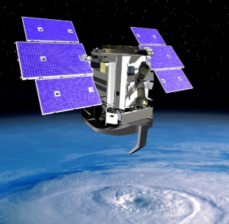
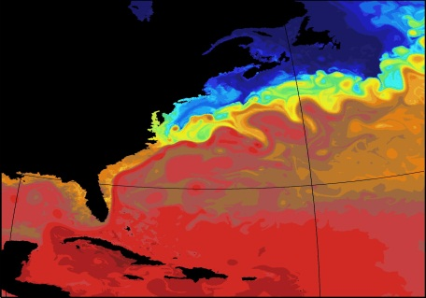
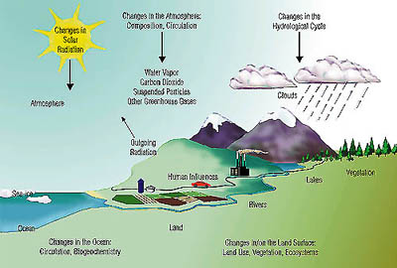
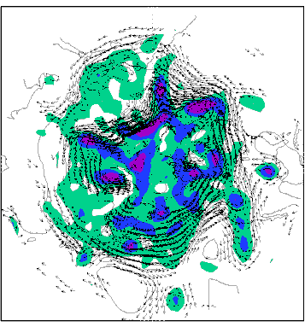
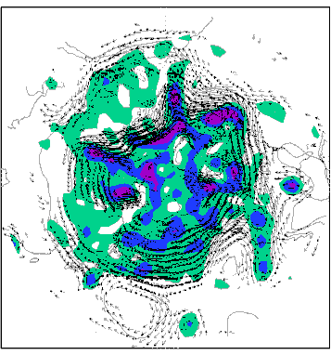
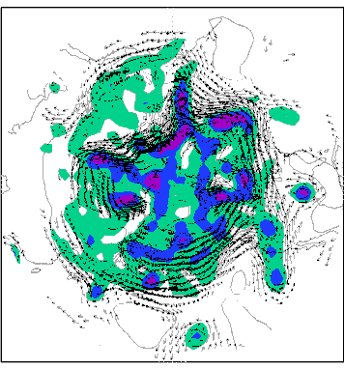
Balancing Future Demands on Computing Power
in climate context
1/12⁰
EO, Data Assimilation
Δx ~ 1km
Resolution
Complexity
Computing
Resources
Ensemble size

Slide 5
Outline
Background of the research
Introduction to NICAM
  Example: Athena project
  ICOMEX
  NICAM numerics
  Computational strategy
Main topics of researches
  MJO studies on the Earth Simulator
K-computer studies
  More resolution: dx=870m
  More ensemble studies: MJO case sweep exp.
  Earth observation collaborations
  Longer integration: future change in tropical cyclones

Slide 6
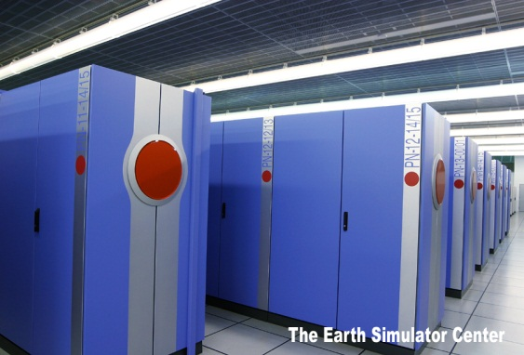

NICAM: Nonhydrostatic Icosahedal Atmospheric Model
Development since 2000
  Tomita and Satoh (2005, Fluid Dyn. Res.)
  Satoh et al. (2008, J. Comp. Phys.)
First global dx=3.5km run in 2004 using the Earth Simulator (JAMSTEC)
  Tomita et al.(2005, Geophys. Res. Lett.)
  Miura et al.(2007, Science)
International collaborations
  Athena project (2009-10): COLA, NICS, ECMWF,
  JAMSTEC, Univ. of Tokyo
  G8-call ICOMEX (2011-): Germany, UK, France, US, Japan
K-computer studies (10PF; Kobe, Riken, since 2012)

Slide 7

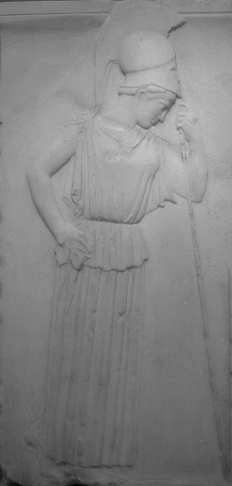
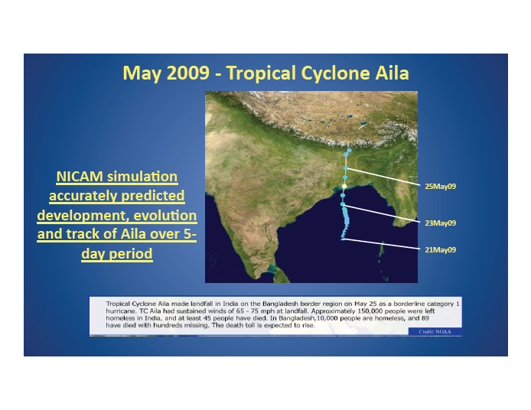
The Athena Project
COLA, ECMWF, JAMSTEC, University of Tokyo, NICS, Cray

Slide 8
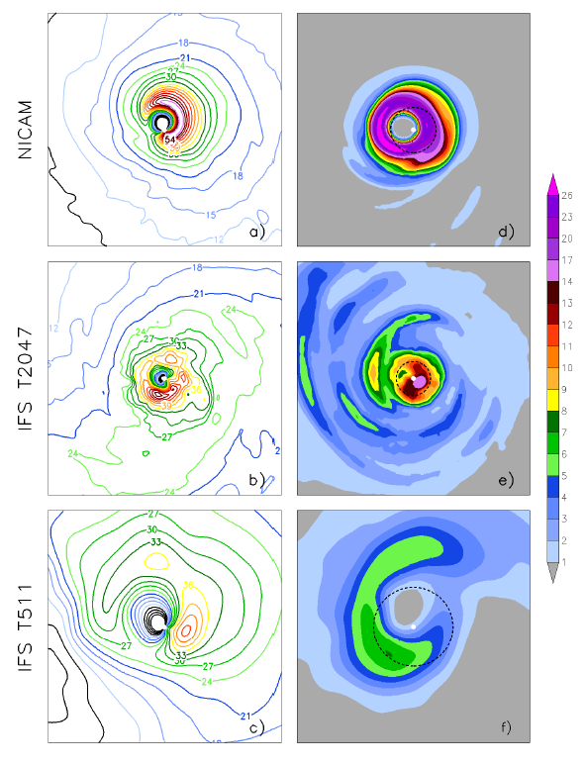
Most intensive Tropical cyclone structure
Distributions of 10m tangential wind (left panels; m s^-1) and total column liquid water and ice (TCLWI; right panels; kg m^-2) for the most intense TCs at the peak of their intensity from the NICAM simulation (panels a and d, labeled “NICAM”), the IFS 10--‐km simulation (panels b and e, labeled “T2047”), the IFS 39km simulation (panels c and f, labeled “T159”), respectively. Radius is 2°Contour interval is 3 m s^1 for wind Dashed black contours in panels d, e and f show the radius of maximum winds for each case with respect to the center of the storm determined from the location of maximum vorticity at 925 hPa (1000 hPa for the IFS cases).
Kinter et al.(2013,BAMS)

Slide 9
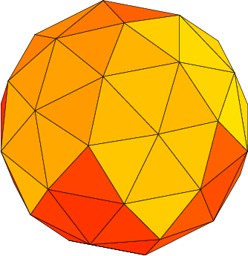
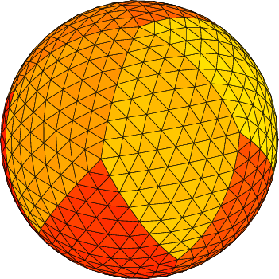

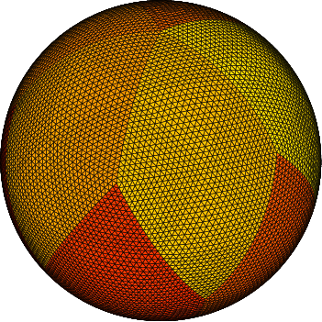
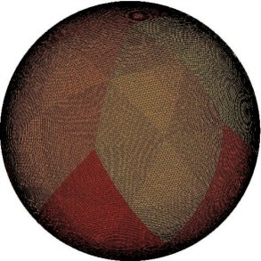
NICAM
Nonhydrostatic Icosahedral Atmospheric Model
Glevel-1
Glevel-2
Glevel-3
Glevel-4
Glevel-5
Glevel-6

Slide 10
Number of Grid points, horizontal resolution
g-level | Grid Number | Horizontal Resolution [km]
5 | 10,242 | 223.2
6 | 40,962 | 111.6
7 | 163,842 | 55.80
8 | 655,362 | 27.90
9 | 2,621,442 | 13.95
10 | 10,485,762 | 6.974
11 | 41,943,042 | 3.487
12 | 167,772,162 | 1.744
13 | 671,088,642 | 0.872
14 | 2,684,354,562 | 0.440

Slide 11
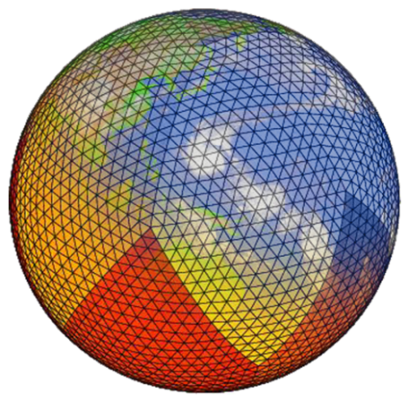
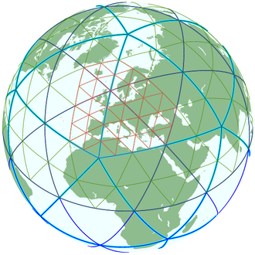
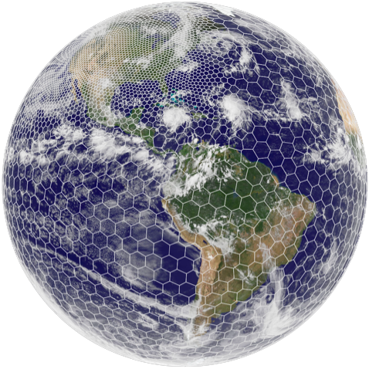
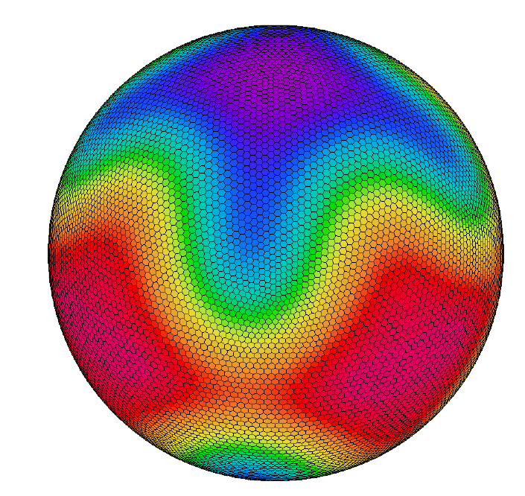
G8 call, ICOMEX, WP1, intercomparison of icosahedral grid models
NICAM
Japan
Main Developer:
Hirofumi Tomita (AICS), Masaki Satoh(U.Tokyo)
Develop. Time：over 10 yrs
Grid System:
H: Structured A-grid
V: height base terrain following (z*) with Lorenz grid
ICON
Germany
Main Developer:
Zängl Günther (DWD), Marco Giorgetta (MPI-M)
Develop. Time：over 10 yrs
Grid System:
H: Unstructured triangular C-grid
V: hydrostatic pressure based terrain following with Lorenz grid (?)
MPAS
US
Main Developer:
William C. Skamarock(UCAR)
Develop. Time：6~7 years
Grid System:
H: Unstructured, Spherical Centriodal Voronoi Tesselations, C-grid
V: height based terrain following, w is vertically staggered (?)
DYNAMICO
France
Main Developer:
Thomas. Dubos (IPSL), Yann Meurdesoif (LMD)
Develop. Time：5~6 years
Grid System:
H: Structured hexagonal C-grid
V: hydrostatic pressure based terrain following (?)
＊hydrostatic model
＊MPAS contributed for ICOMEX through Prof. John Thuburn. Operation was
technically supported by Dr. Michel Duda (UCAR).

Slide 12
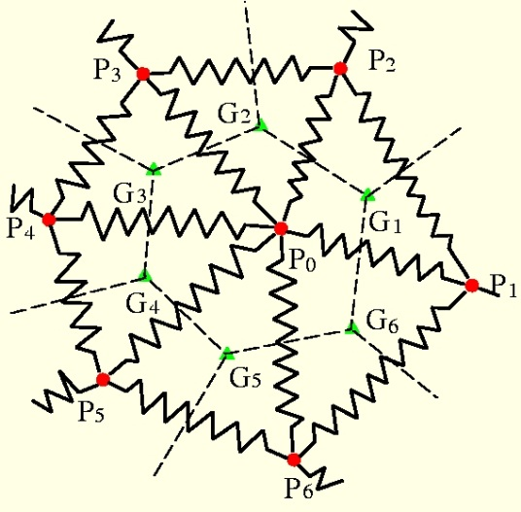
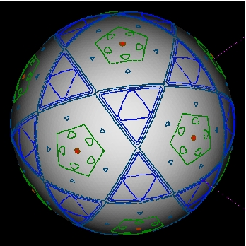
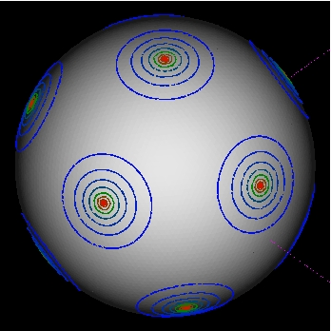
Nonhydrostatic Icosahedarl Atmospheric Model
Icosahedral grid with spring dynamics smoothing
    Tomita et al.(2001, J. Comp. Phys.)
    Tomita et al.(2002, J. Comp. Phys.)
Flux-form conservative nonhydrostatic scheme
  Split-explicit time integration
  mass and total energy & momentum conserving
    Satoh (2002, Mon. Wea. Rev.)
    Satoh (2003, Mon. Wea. Rev.)
Area distribution of cell: before and after

Slide 13
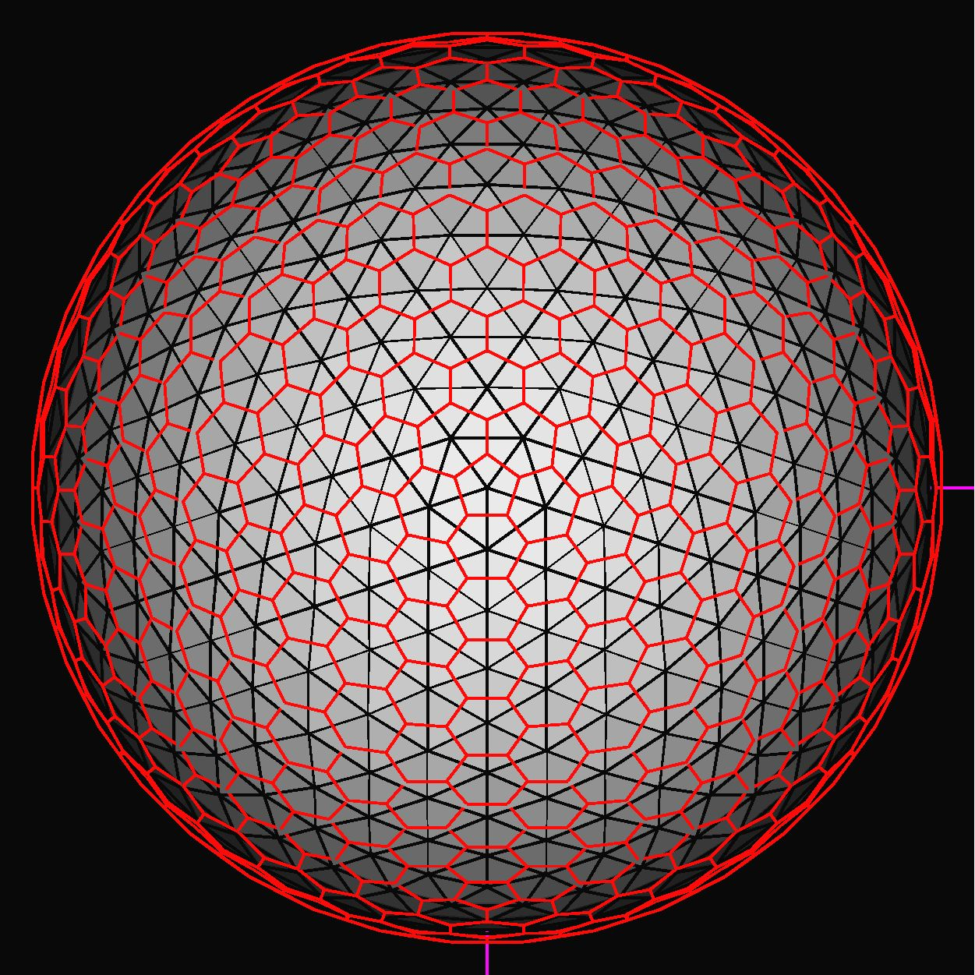
Grid arrangement
Arakawa A-grid type
  Velocity, mass
    triangular vertices
  Control volume
    Connection of center of triangles
      Hexagon
      Pentagon at the icosahedral vertices
Advantage
  Easy to implement
  Less computational mode
    Same number of grid points for vel. and mass
Disadvantage
  Non-physical
  2-grid scale structure
    E.g. bad geostrophic adjustment
Glevel-3 grid & control volume

Slide 14
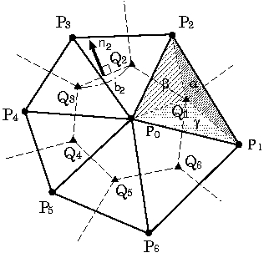
Horizontal differential operator
e.g. Divergence
  Vector : given at P_{i}
  Interpolation of u at Q_{i}
  Gauss theorem
2nd order accuracy?
NO
→ Allocation points is not gravitational center ( default grid )

Slide 15
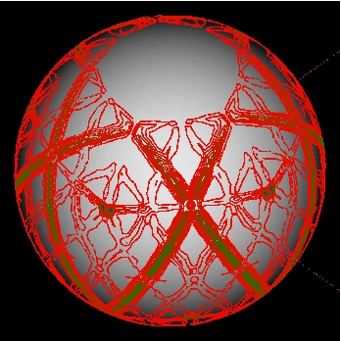
Error distribution of div U
Error of divergence operator
Area of CV
Error of div operator
  Large error on the original icosahedral arc
    Fractal distribution
  Generation of grid noise
Distribution of CV area
  Fractral distribution
GUESS:
smoothness of CV
→ Reduction of grid noise

Slide 16
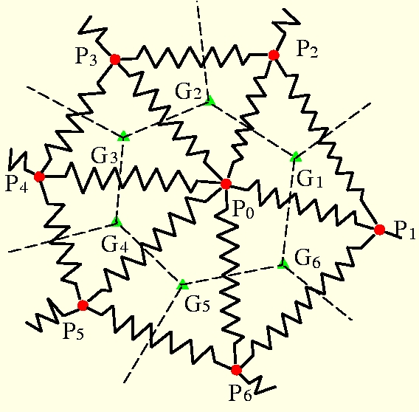
Modified Icosahedral Grid
Reconstruction of grid by spring dynamics
  To reduce the grid-noise
STD-grid :
Generated by the recursive grid division.
SPRING DYNAMICS :
Connection of gridpoints by springs

Slide 17
Modified Icosahedral Grid
SPR-grid
  Solve the spring dynamics
    → The system calms down to the static balance
  Construction of CV
    Connection of the center of triangles
One non-dimensional parameter β
  Natural length of spring
    Should be tuned!

Slide 18
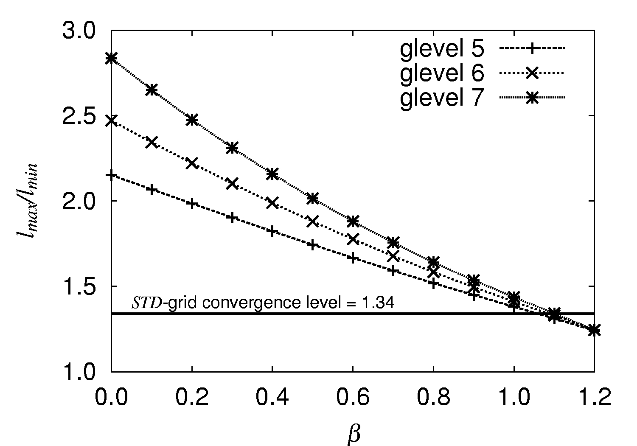
Dependency of β on homogeneity
The ratio of lmax / lmin against the parameter β
The standard grid
l_{max}/l_{min} → 1.34.
The spring grid
l_{max}/l_{min} depends on β and glevel.
If β =1.2, lmax/lmin → 1.24.

Slide 19
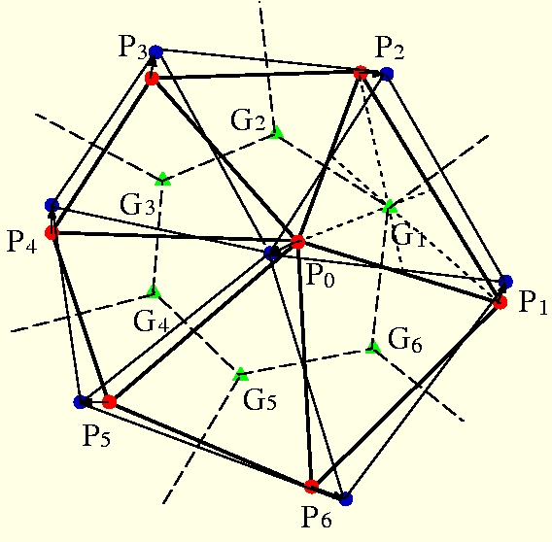
Modified Icosahedral Grid
Gravitational-Centered Relocation
  To make the accuracy of numerical operators higher
SPR-grid:
Generated by the spring dynamics. → ●
CV:
Defined by connecting the GC of triangle elements.
→ ▲
SPR-GC-grid:
The grid points are moved to the GC of CV.
→ ●
→ The 2nd order accuracy of numerical operator
is perfectly guaranteed at all of grid points.

Slide 20
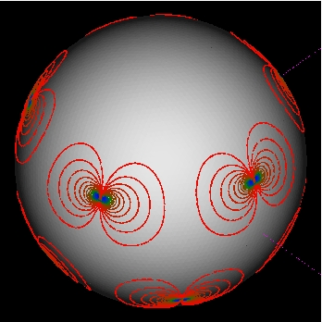
Improvement of error distribution
- Area of CV - Error of divergence
STD-grid
STD-grid
  Area of CV
    Fractral distribution
    due to recursive division
  Error of divergence
    Fractral distribution error
    Generation of grid noise
SPR-GC-grid
  Area of CV
    Smooth distribution
  Error of divergence
    Smooth distribution
    → Reduction of grid noise
SPR-GC-grid

Slide 21
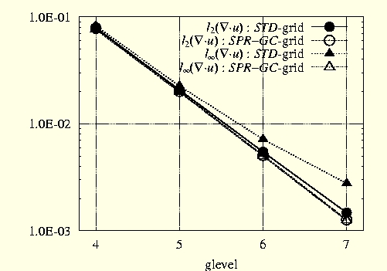
Improvement of accuracy of operator
Test function
  Heikes & Randall(1995)
Error norm
  Global error
  Local error
 | STD-grid | SPR-GC-grid
L_2 norm | Almost 2nd-order(●) | Perfect 2nd-order(○)
l_inf norm | Not 2nd order(▲) | Perfect 2nd-order(△)

Slide 22
Nonhydrostatic scheme
Prognostic variables
density
horizontal momentum
vertical momentum
total energy
Metrics
    Satoh (2002, 2003)

Slide 23
Model description
Dynamics
Governing equations | Fully compressible non-hydrostatic system
Spatial discretization Horizontal grid configuration Vertical grid configuration Topography | Finite Volume Method (Tomita et al. 2001,2002) Icosahedral grid Lorenz grid Terrain-following coordinate
Conservation | Total mass, total energy (Satoh 2002,2003)
Temporal scheme | Slow mode － explicit scheme （RK2, RK3） Fast mode － Horizontal Explicit Vertical Implicit scheme
Advection scheme | Conservative and monotonic Miura (2004), Niwa et al.(2011)
Physics
Turbulence, surface flux | MYNN(Nakanishi and Niino 2004; Mellor & Yamada 2,2.5,3)/Louis(1979), Uno et al.(1995), Moon et al. (2007)
Radiation | MSTRNX (Sekiguchi and Nakajima, 2005)
Cloud physics | Kessler; Grabowski(1998); Lin et al.(1983); NSW6(Tomita 2008);NDW6(Seiki et al. 2011);WSM3-6 (Hong et al. 2004)
Subgrid convection | Prognostic AS, Kuo, Chikira (Chikira and Sugiyama 2010), Tiedtke (1989)
Land and sea processes | Mixed layer/bucket; MATSIRO (Takata et al. 2003)

Slide 24
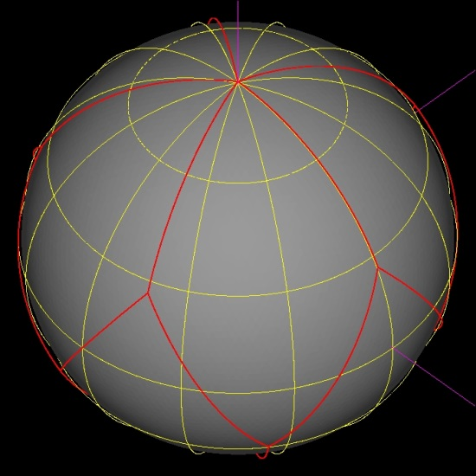
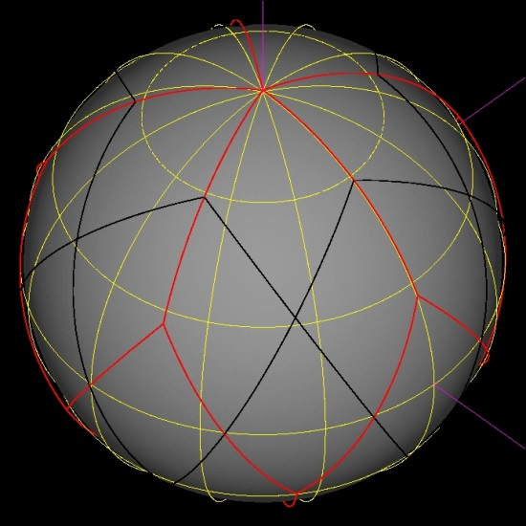
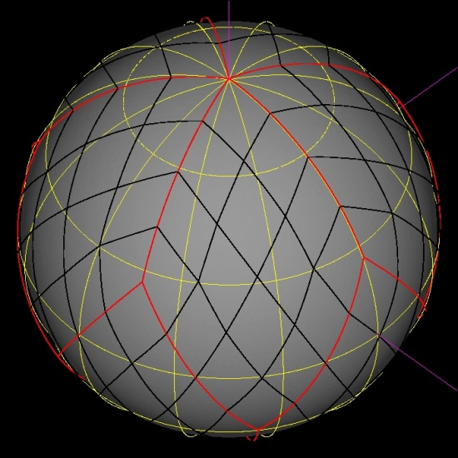
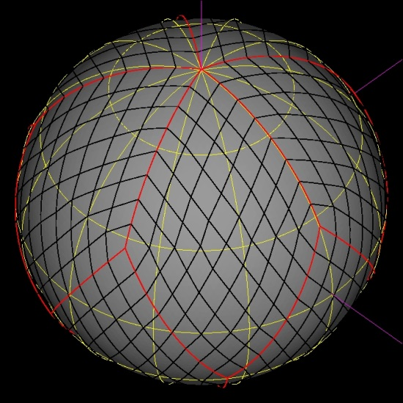
Computational strategy
(0) region division level 0 (1) region division level 1
Domain decomposition
  By connecting two neighboring icosahedral triangles, 10 rectangles are constructed. (rlevel-0)
  For each of rectangles, 4 sub-rectangles are generated by connecting the diagonal mid-points. （rlevel-1)
  The process is repeated.
  (rlevel-n)
(2) region division level 2 (3) region division level 3

Slide 25
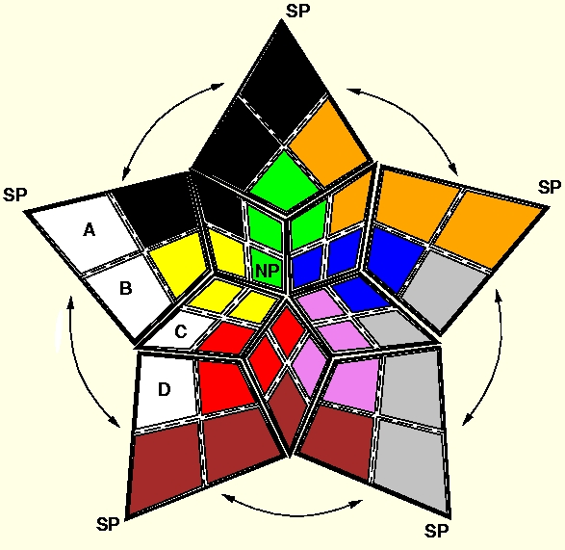
Example ( rlevel-1 )
  # of region : 40
  # of process : 10
  Situation:
    Polar region:
    Less computation
    Equatorial region:
    much computation
Each process
  manage same color regions
  Cover from the polar region and equatorial region.
Load balancing
Avoid the load imbalance

Slide 26
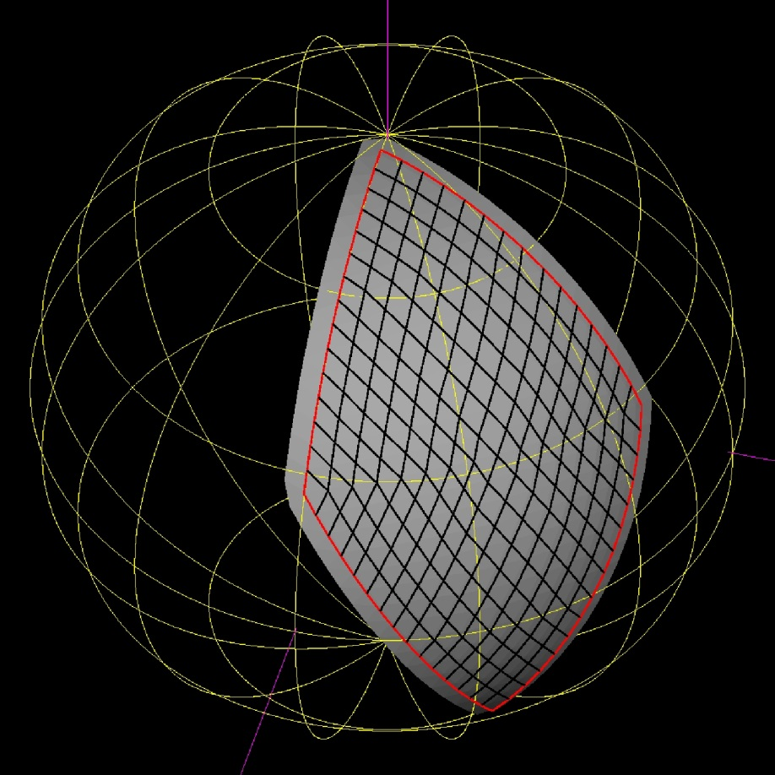
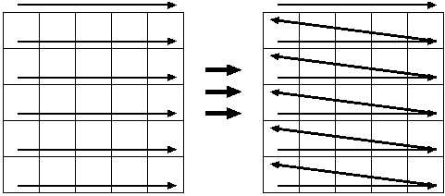
Vectorization
Structure in one region
  Icosahedral grid
    → Unstructured grid?
  Treatment as structured grid
  → Fortran 2D array
  → vectorized efficiently!
2D array → 1D array
  Higher vector operation length

Slide 27
Outline
Background of the research
Introduction to NICAM
  Example: Athena project
  ICOMEX
  NICAM numerics
  Computational strategy
Main topics of researches
  MJO studies on the Earth Simulator
K-computer studies
  More resolution: dx=870m
  More ensemble studies: MJO case sweep exp.
  Earth observation collaborations
  Longer integration: future change in tropical cyclones

Slide 28
Main research targets
Multi-scale processes of convective systems in the tropics
  Madden-Julian Oscillations
  Tropical cyclones
Clouds
  Future cloud changes, cloud feedbacks
Satellite collaborations

Slide 29
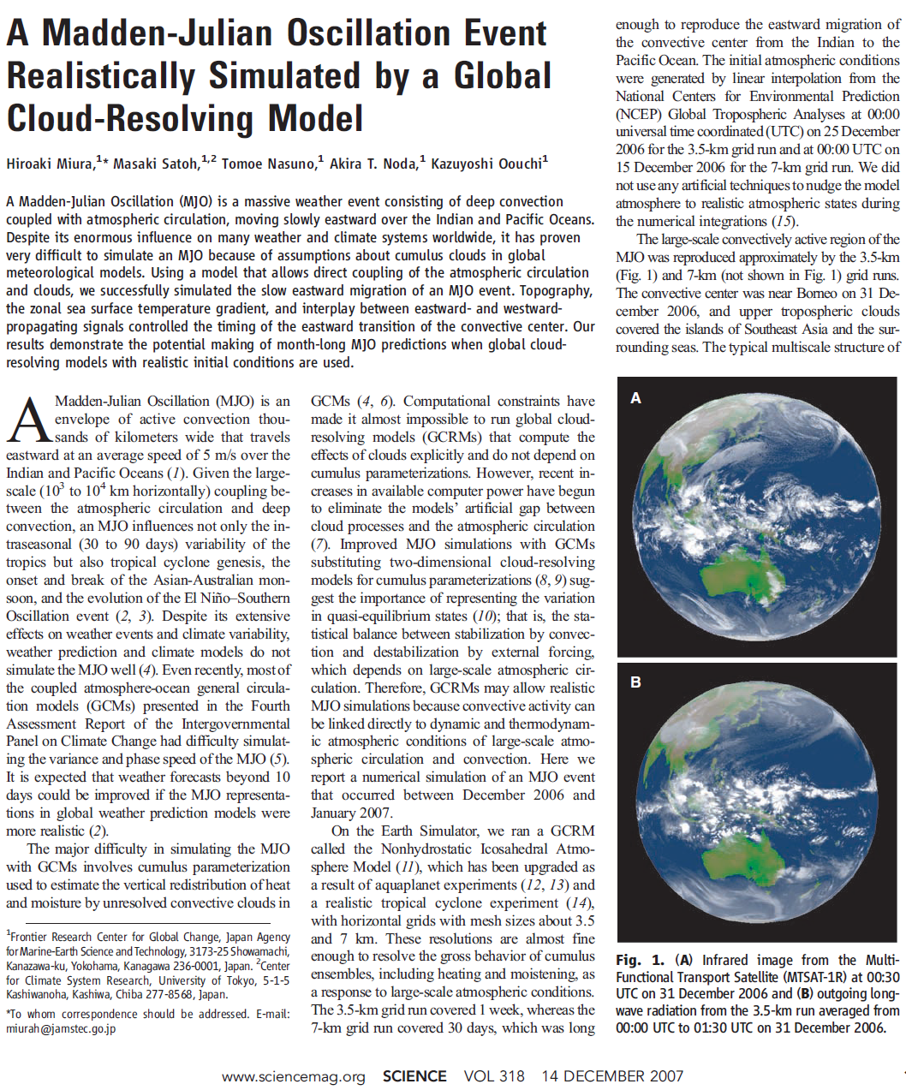
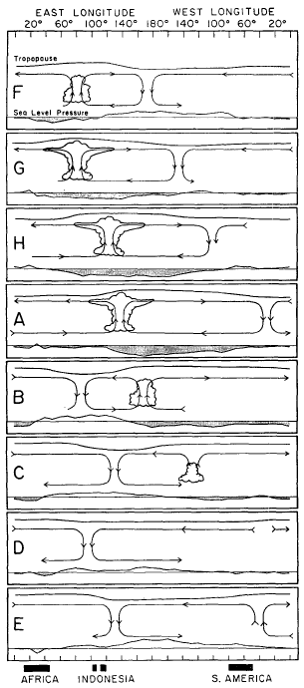
Miura et al.(2007,Science)
Madden andJulian (1972)

Slide 30
Madden Julian Oscillation studies
Multi-scale structure of tropical convective systems
  MJO O(10,000km), Super Cloud Clusters: O(1,000km), Cloud Clusters:O(100km), Meso-circulation O(10km), Convective core: O(km)
Eastward propagation along equator
Aqua Planet Experiment
  Tomita et al.(2005,GRL), Satoh et al.(2006,JES)
  Nasuno et al.(2008ab,JAS)
Case study of an MJO event
  Miura et al.(2007,Science)
  Nasuno et al.(2009,JMSJ)

Slide 31
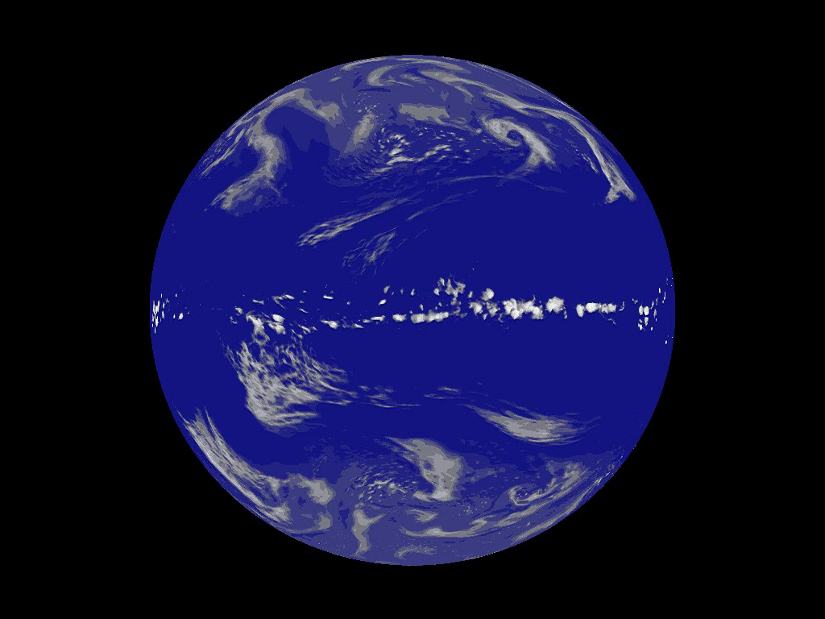


Slide 32
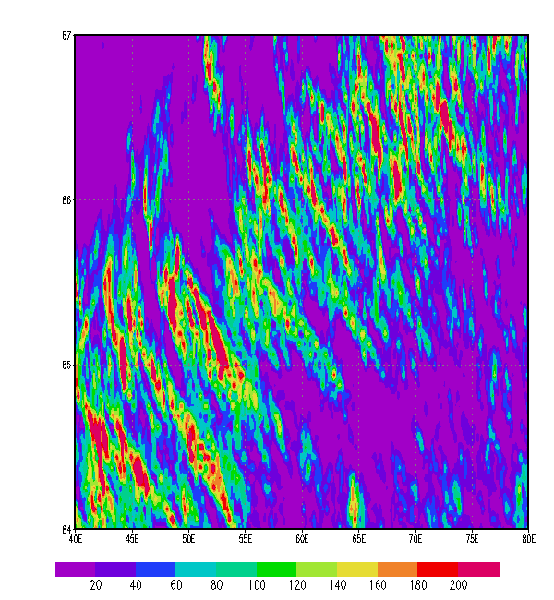
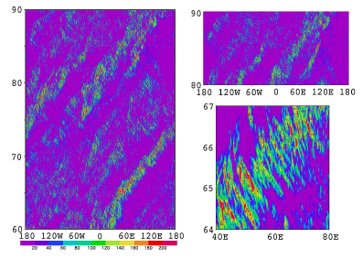
NICAM APE simulations precipitation along equator (2S-2N)
dx=7km
dx=3.5km
87d
86d
85d
84d
40E 60E 80E
Tomita et al. (2005), Satoh et al.(2005)

Slide 33
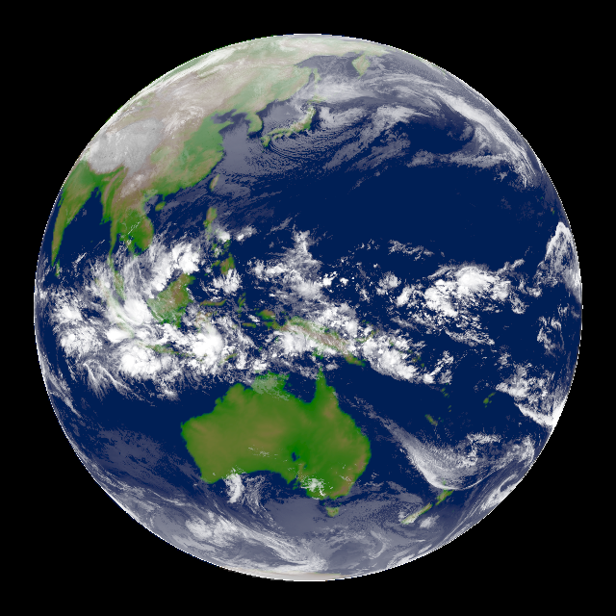

MJO simulation, Dec.2006-Jan.2007 (Miura et al., 2007)
MTSAT-1R
NICAM
MJO-organized clouds
MJO-organized clouds
TS Isobel
TS Isobel
Dec. 29 2006
2weeks after initialization
A Madden-Julian Oscillation event realistically simulated by a global cloud-resolving model, and also the embedded mesoscale features, such as TC rainbands.
Surface rain rate (mm hour⁻¹) by TRMM-TMI
Surface rain rate (mm hour⁻¹) by NICAM
0920 UTC 2 Jan.
300km
Latitude
2230 UTC 2 Jan.

Slide 34
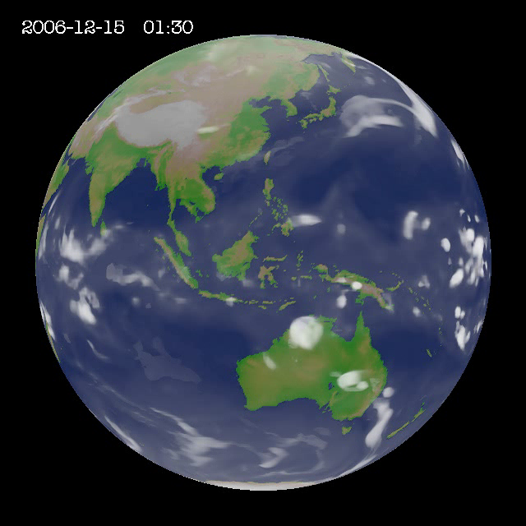
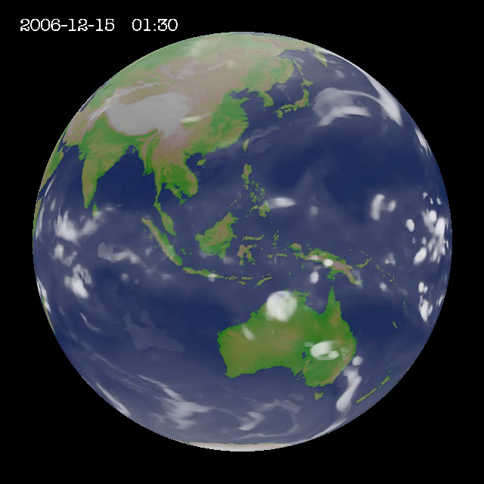
NICAM 7km simulation: 2006.12.15-2007.1.15: Miura et al.(2007)
Notes:
NICAMのシミュレーションのアニメーション。MJOがゆっくりインド洋から日付変更線まで進んでいく様子。

Slide 35
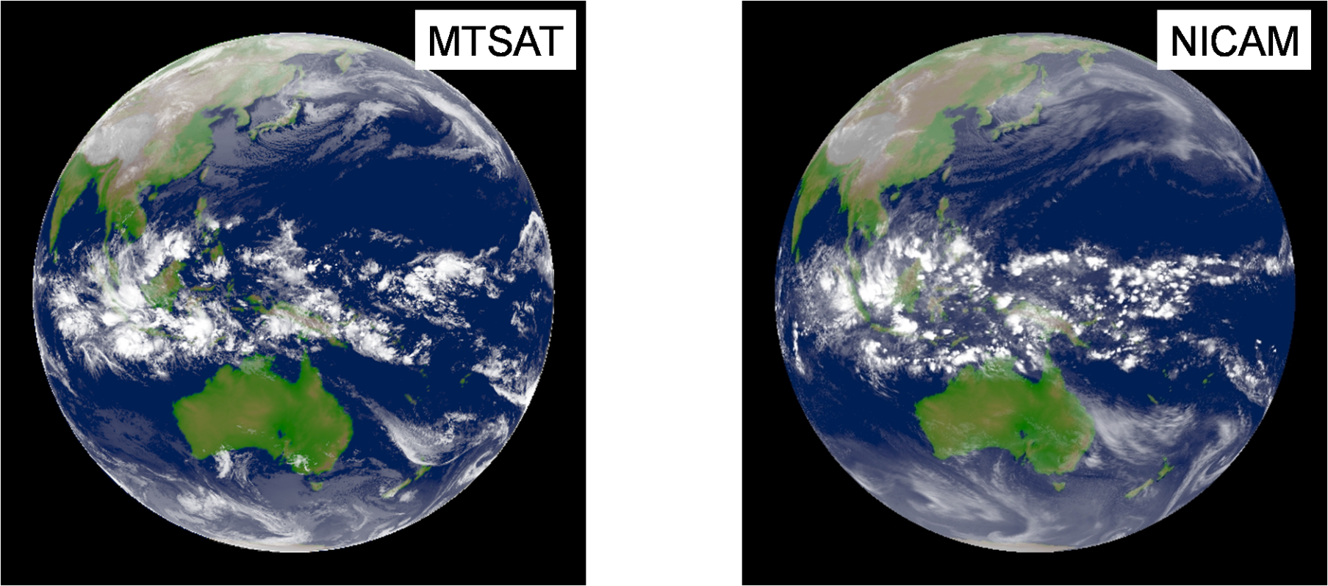

ES-era : MJO case studies
NICAM has previously demonstrated its potential to produce “good looking” MJOs.
MJO cloud clusters observed from satellite and reproduced by NICAM
Miura et al. (2007,Science)
Plan views of CMT displayed relative to center of MJO
Miyakawa et al. (2012.JAS)

Slide 36
Outline
Background of the research
Introduction to NICAM
  Example: Athena project
  ICOMEX
  NICAM numerics
  Computational strategy
Main topics of researches
  MJO studies on the Earth Simulator
K-computer studies
  More resolution: dx=870m
  More ensemble studies: MJO case sweep exp.
  Earth observation collaborations
  Longer integration: future change in tropical cyclones

Slide 37

K-computer studies
Higher resolution global simulation: dx=870m
Multi-ensembles: MJO case sweep ensemble
Multi year experiments: 30 years AMIP-like experiment
Now we entered a new era in which plenty of global non-hydrostatic simulations can be run

Slide 38
Balancing Future Demands on Computing Power
in climate context
1/12⁰
EO, Data Assimilation
Δx ~ 1km
Resolution
Complexity
Computing
Resources
Ensemble size

Slide 39


NICAM peformance on K-computer: Sep. 2012
Measurement up to 20000 nodes (weak scaling)
Experiment done until 81920 nodes (K full nodes), tentative
Good scaling for the major modules （α=0.94~0.97）
DX=60km
DX=3.5, 7, 14km
DX=800m
DX=400m
Computational time [sec]
Computational efficiency[%]
tentative
=K full nodes
Notes:
京コンピュータのパフォーマンス。全京を使って400mメッシュ計算を実施。良好なスケーラビリティ。１０％弱の効率。

Slide 40






GL08
28km
GL09
14km
GL10
7km
GL11
3.5km
GL12
1.7km
GL13
870m
6UTC, 25 Aug. 2012
Miyamoto et al. (2013, Geophys. Res. Lett.)

Slide 41

Δ870 m

Slide 42



Convective core
Detection of a convective core:
maximum of vertical velocity w
ISCCP category: deep convection
Δx = 1.7 km
vertical average of
w = 0.1 m s⁻¹
Δx = 7 km
Convective core grid

Slide 43
Composite of convection (vertical velocity)
Δ14.0 km
Δ7.0 km
Δ3.5 km
Δ1.7 km
Δ0.87 km
Δx ≧ 3.5 km:
  Convection is represented at 1 grid
  Little dependence on resolution
Δx ≦ 1.7 km:
  Convection is represented at multiple grids
  Intensify w/ resolution

Slide 44
Balancing Future Demands on Computing Power
in climate context
1/12⁰
EO, Data Assimilation
Δx ~ 1km
Resolution
Complexity
Computing
Resources
Ensemble size

Slide 45

A MJO Case sweep experiment
(Tomoki Miyakawa)
Assigning initial dates
Criteria:
・2003 - 2012, Winter cases (October – March)
・Average amplitude of phases 2 – 5 ≧ 1 in RMM diagram (Wheeler and Hendon 2004)
http://www.bom.gov.au/climate/mjo/graphics/rmm.74toRealtime.txt
⇒ 19 cases
Initial dates:
・The first day the MJO enters Phase 2
・The first day the MJO enters phases 1 and 8,
if traceable.
⇒ 54 initial dates
RMM diagram of CINDY/DYNAMO MJO cases.
(NOAA-OLR + NCEP reanalysis)
Initial dates used for simulations are marked by
orange circles (10, 15, 20 Oct and 13, 17, 21 Nov).
http://www.bom.gov.au/climate/mjo/

Slide 46














Examples of MJO simulations for 40 days
Upper clouds: longitude-time diagram
observation
NICAM
0 day
40day
0 90E 180 90W 0 0 90E 180 90W 0

Slide 47

Bivariate correlation with regards of lead time
(Lin et al. 2008, Gottschalck et al. 2010)
COR
phase 1 start
phase 2 start
phase 8 start
all (54 cases)
days
COR > 0.6 for 26 – 28 days

Slide 48

GPCP - 1dd NICAM

Slide 49




Effects of MJO on Japanese winter
Nov. 2011: Active MJO over the Indian Ocean
caused hot November in Japan
cf. Nov. 20: 25.9℃ at Kanagawa
Temperature anomaly of Nov. 2011
（low level）
（middle level）
NICAM simulation
Initialized from Oct. 10, 2011
Observation
（JRA-55）

Slide 50
Balancing Future Demands on Computing Power
in climate context
1/12⁰
EO, Data Assimilation
Δx ~ 1km
Resolution
Complexity
Computing
Resources
Ensemble size

Slide 51


NICAM 3.5 km mesh
2008/06/20 12UTC
TC Fengshen

Slide 52




J-simulator (Joint Simulator for Satellite Sensors) by T. Hashino and the EarthCARE team
  - Simulate EarthCARE (2014) observations from CRM outputs.
  - Built on Satellite Data Simulator Unit (SDSU)
    Masunaga et al. (2010, BAMS)
  - Extension at NASA/Goddard: Goddard-SDSU
    courtesy of T. Matsui & NASA GPM team
VIS 0.62 μm
IR 10.8 μm TB [K]
IR 10.8 μm TB [K]
Observation
MTSAT (MRI, Japan; Chiba Univeristy, CEReS)+ globally-merged IR (CPC, NOAA)
94 GHz CPR [dBZ] at h=10 km
532 nm backscat coef Log10[1/m/str] at h=14 km
Pol diff for 19GHz
Cross section through the TC at longitude 127E
http://www22.atwiki.jp/j-simulator/
Examples of simulated signals
Notes:
Reference:
Satellite Data Simulator Unit (SDSU): A multi-sensor, multi-spectral satellite simulator package
Hirohiko Masunaga, Toshihisa Matsui, Wei-kuo Tao, Arthur Y. Hou, Christian D. Kummerow, Teruyuki Nakajima, Peter Bauer, William S. Olson, Miho Sekiguchi, Takashi Y. Nakajima
Bulletin of the American Meteorological Society
Volume 0, Issue 0 ( ) pp.
doi: 10.1175/2010BAMS2809.1

Slide 53
Balancing Future Demands on Computing Power
in climate context
1/12⁰
EO, Data Assimilation
Δx ~ 1km
Complexity
Resolution
Computing
Resources
More integration
Ensemble size

Slide 54



Future change of tropical cyclones
NICAM 10years simulation (present & future)

Slide 55

Tropical cyclone frequency
NWP
NEP
NA
NI
NICAM simulations
TC number reduces over almost all the basins except for the central Pacific
(NCP: 150W-150E)
SI
SP
SA
Definition of basins
 | GL | NH | SH | NI | NWP | NEP | NA | SI | SP | NCP | SA
Obs | 109.7 | 73.7 | 36.0 | 5.0 | 33.6 | 20.4 | 14.7 | 21.7 | 14.3 | 7.9 | 0.0
Present | 93.3 | 58.1 | 35.2 | 5.8 | 28.6 | 20.1 | 3.7 | 19.1 | 15.6 | 8.2 | 0.6
Future | 71.4 | 44.0 | 27.4 | 5.6 | 23.3 | 12.6 | 2.6 | 13.1 | 13.8 | 9.0 | 0.6
DIFF | -21.9 | -14.1 | -7.8 | -0.2 | -5.2 | -7.6 | -1.1 | -6.0 | -1.8 | 0.8 | 0.0

Slide 56


Intensity
Maximu wind speed
6.4% increase
Sea level pressure
0.9% intendity
Blue: observation
Black: present
Red: future
var | case | Min | Max | Mean
Sea level pres. (hPa) | Obs | 882 | 1009 | 970.0
 | Present | 897.59 | 1004.4 | 971.2
 | Future | 889.28 | 1004.0 | 970.0
Max.wind speed (ms⁻¹) | Obs | 17.52 | 82.24 | 38.4
 | Present | 20.4 | 61.1 | 36.5
 | Future | 21.7 | 64.8 | 37.3

Slide 57



Change in TCs approaching Japan
TC passing
the area (30-45N, 130-145E)
TC numbers
57 ➔ 51
10% reduction
Present strongest TC
Landfall on Shizuoka~Kanagawa
SLP: 950-940 hPa
MWS: 50.5 m/s
Future strongest TC
Landfall on East of Chiba
SLP: 930 hPa
MWS: 50.5 m/s

Slide 58
Summary
NICAM: over 10 years development
  Similar icosahedral models being developed in many countries
Multi-scale structure of convective systems
Synergy with earth observations
NICAM researches using K-computer
A sub-kilometer experiment
Extended forecast for one-month
Future change of tropical cyclones

